Slide 1
Creational Design Patterns
Instructor: Mehroze Khan

Slide 2
Creational Design Patterns
Creational design patterns provide various object creation mechanisms, which increase flexibility and reuse of existing code.
Creational design patterns abstract the instantiation process.
They help make a system independent of how its objects are created, composed, and represented.
A class creational pattern uses inheritance to vary the class that's instantiated.
An object creational pattern will delegate instantiation to another object.

Slide 3
Creational Design Patterns
First, they all encapsulate knowledge about which concrete classes the system uses.
Second, they hide how instances of these classes are created and put together.
Creational patterns give you a lot of flexibility in what gets created, who creates it, how it gets created, and when.

Slide 4
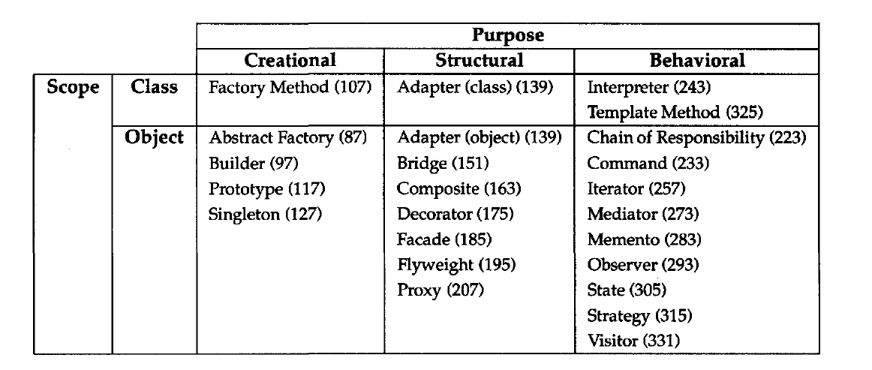
Catalog of Design Patterns

Slide 5
Factory Method Pattern

Slide 6
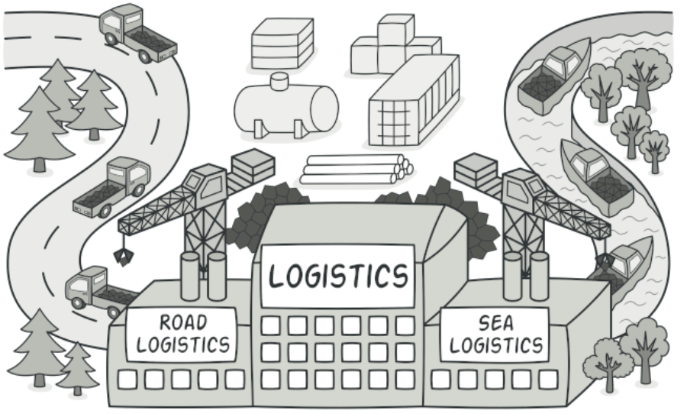
Factory Method
Intent:
Factory Method is a creational design pattern that provides an interface for creating objects in a superclass but allows subclasses to alter the type of objects that will be created.
It is also known as Virtual Constructor

Slide 7
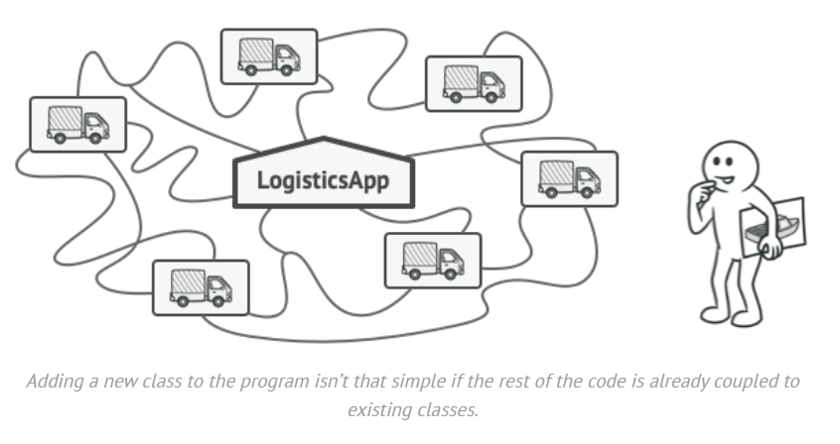
Problem
Imagine that you’re creating a logistics management application. The first version of your app can only handle transportation by trucks, so the bulk of your code lives inside the Truck class.
After a while, your app becomes popular. Each day you receive dozens of requests from sea transportation companies to incorporate sea logistics into the app.

Slide 8
Problem
At present, most of your code is coupled to the Truck class. Adding Ships into the app would require making changes to the entire codebase.
Moreover, if later you decide to add another type of transportation to the app, you will probably need to make all these changes again.
As a result, you will end up with nasty code, riddled with conditionals that switch the app’s behavior depending on the class of transportation objects.

Slide 9
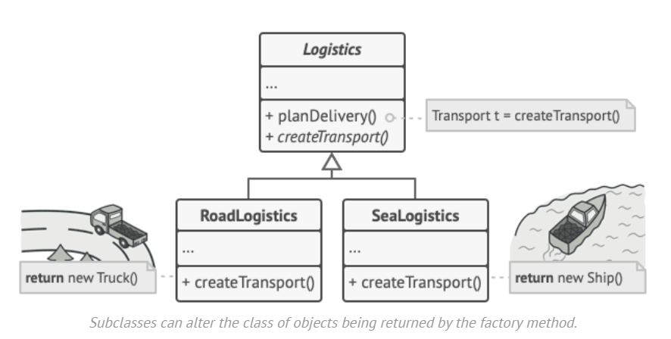
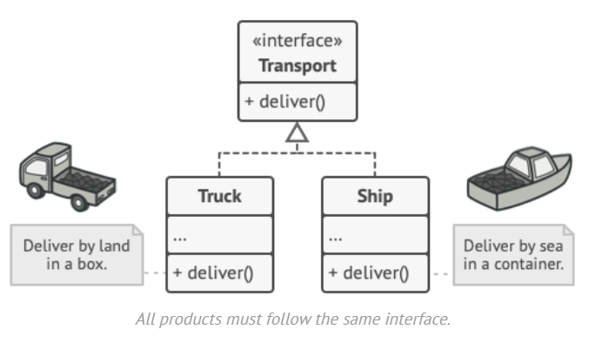
Solution
The Factory Method pattern suggests that you replace direct object construction calls (using the new operator) with calls to a special factory method.
Objects are still created, but it’s being called from within the factory method.
Objects returned by a factory method are often referred to as products.

Slide 10
Solution
At first glance, this change may look pointless: we just moved the constructor call from one part of the program to another.
However, consider this: now you can override the factory method in a subclass and change the class of products being created by the method.
There’s a slight limitation though: subclasses may return different types of products only if these products have a common base class or interface.
Also, the factory method in the base class should have its return type declared as this interface.

Slide 11
Solution
For example, both Truck and Ship classes should implement the Transport interface, which declares a method called deliver.
Each class implements this method differently: trucks deliver cargo by land and ships deliver cargo by sea.
The factory method in the RoadLogistics class returns truck objects, whereas the factory method in the SeaLogistics class returns ships.
Product
Creator
Concrete Product
Concrete Creator

Slide 12
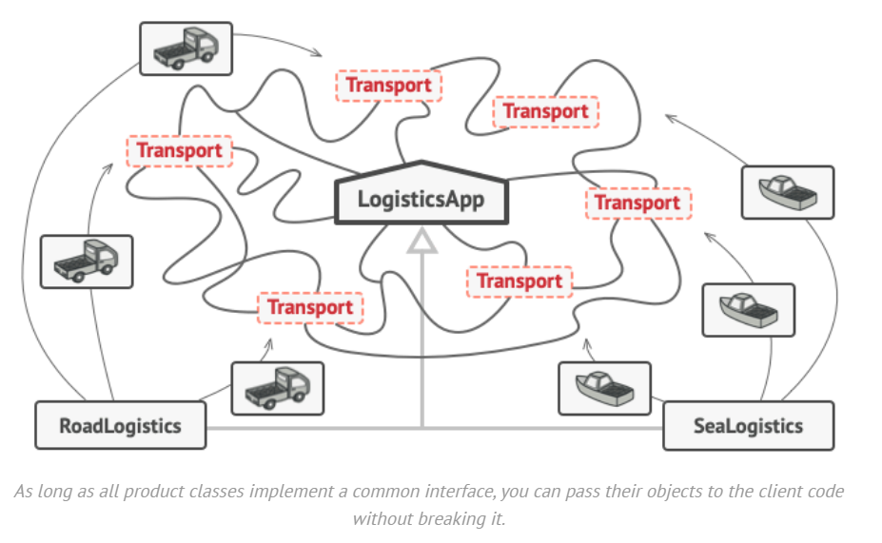
Solution
The code that uses the factory method (often called the client code) doesn’t see a difference between the actual products returned by various subclasses.
The client treats all the products as abstract Transport.
The client knows that all transport objects are supposed to have the deliver method, but exactly how it works isn’t important to the client.

Slide 13
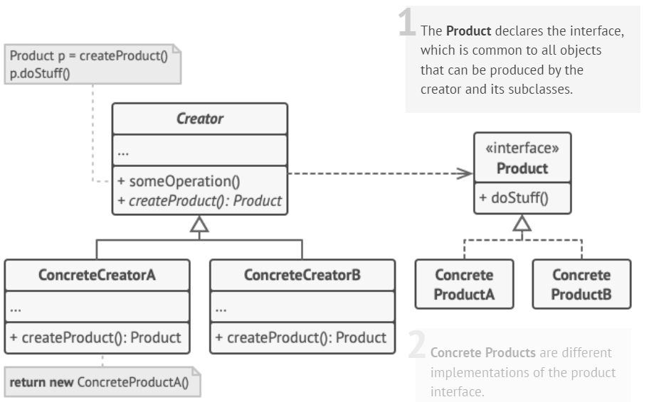
Structure

Slide 14
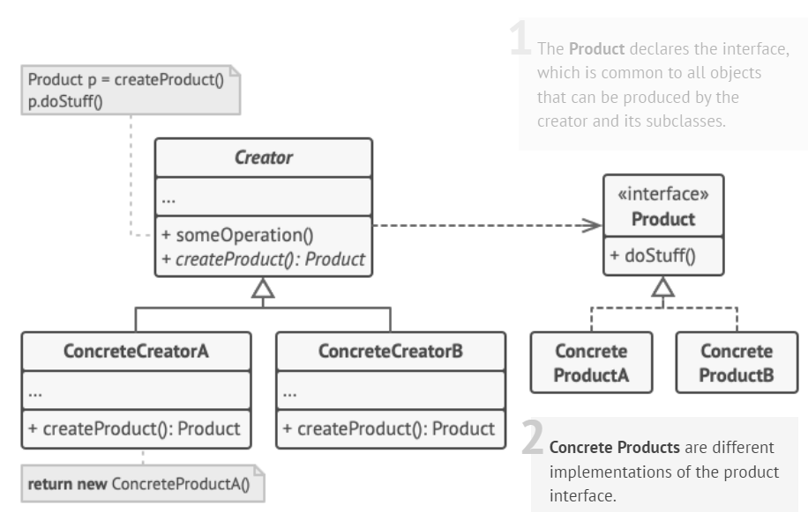
Structure

Slide 15
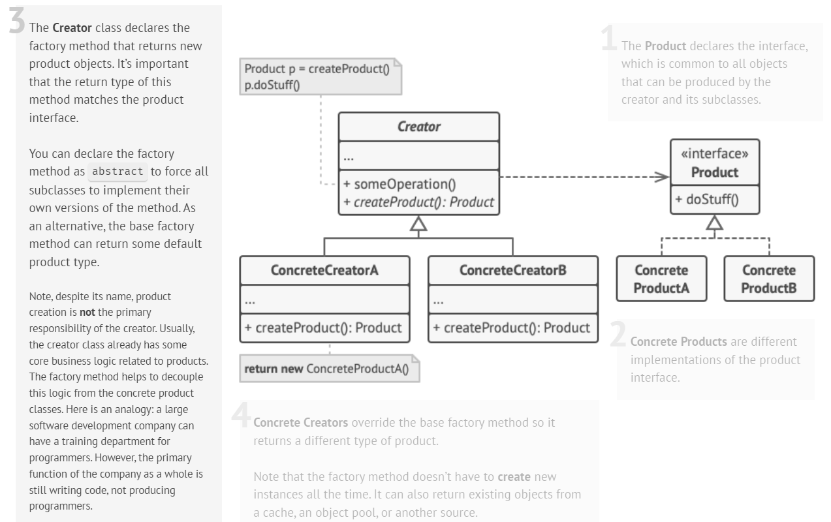

Slide 16
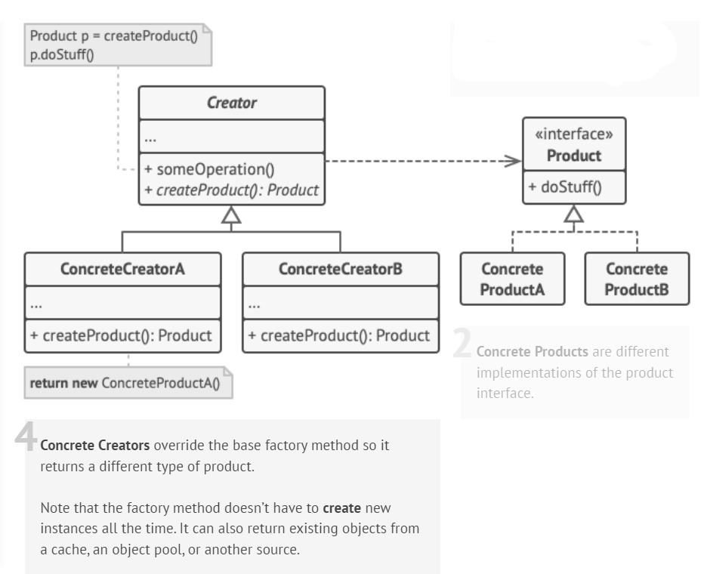
Structure

Slide 17
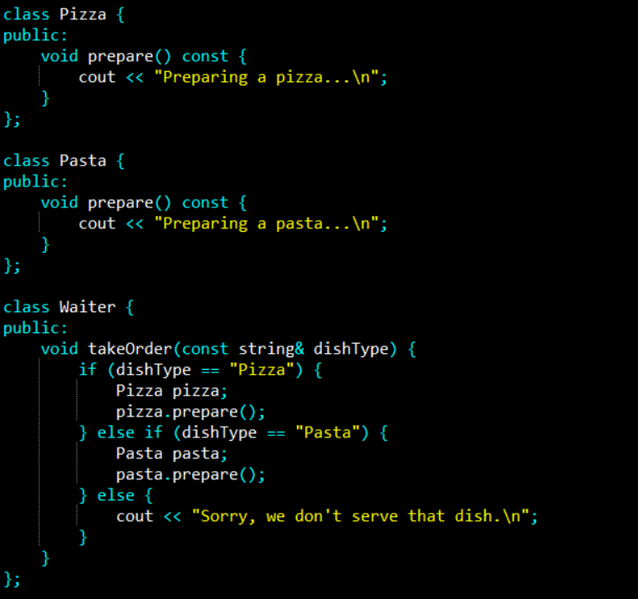
Example

Slide 18
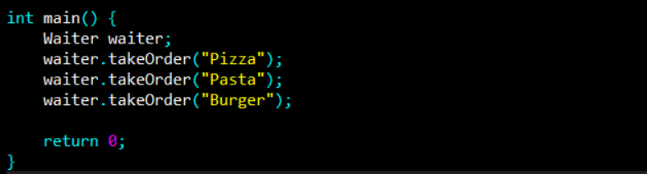
Example
Issues
Tight Coupling: Waiter directly depends on Pizza and Pasta classes, making it difficult to add new dishes without modifying Waiter.
Violation of Open/Closed Principle: New dish types require modification in Waiter

Slide 19
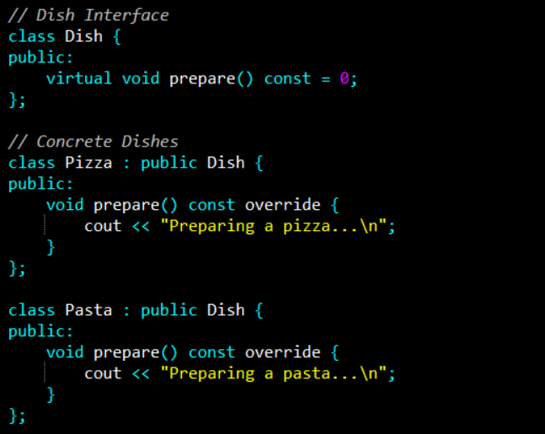
Example (Applying Factory Method Pattern)

Slide 20
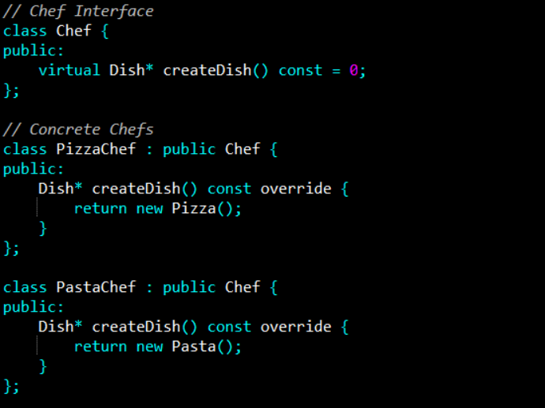
Example (Applying Factory Method Pattern)

Slide 21
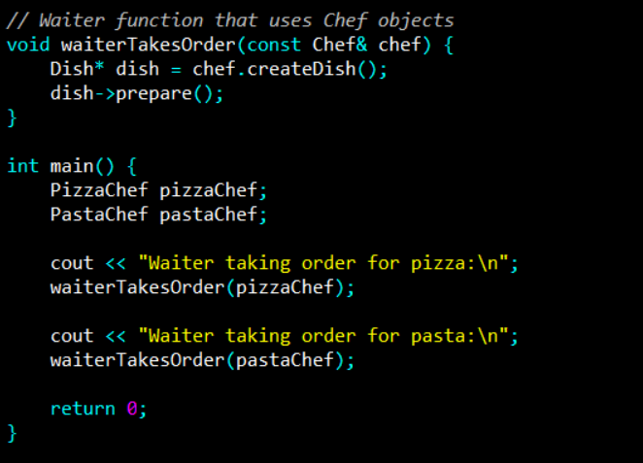
Example (Applying Factory Method Pattern)

Slide 22
Advantages
Reduced Coupling: Waiter no longer needs to know about specific dishes like Pizza or Pasta. It only interacts with the Chef interface, which makes it easy to add new dishes without modifying Waiter.
Scalability: To add a new dish (e.g., Burger), simply create a new Burger class and BurgerChef class without changing the Waiter.

Slide 23
References
Design Patterns: Elements of Reusable Object-Oriented Software, Erich Gamma, Richard Helm, Ralph Johnson, and John Vlissides, Pearson, 1995.
Helping Links:
https://refactoring.guru/design-patterns/
https://www.geeksforgeeks.org/factory-method-for-designing-pattern/
https://sourcemaking.com/design_patterns/

